Slide 1


LINKEDLIST
LEVERAGING C++ STL
Adelaja Qowiyyu
www.ieeextreme.org
adexolamilekan46@gmail.com

Slide 2
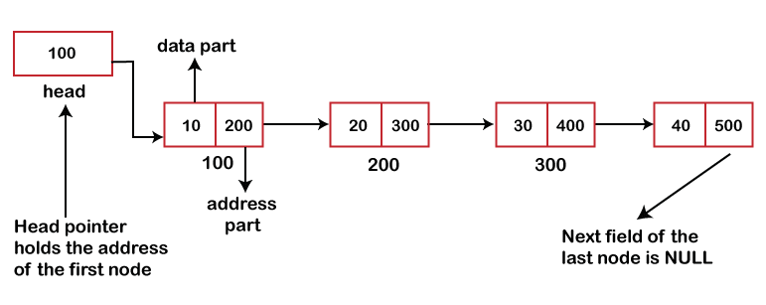
LinkedList?
Image Source: https://www.javatpoint.com/singly-linked-list-vs-doubly-linked-list
Adelaja Qowiyyu
adexolamilekan46@gmail.com
www.ieeextreme.org

Slide 3

What is LinkedList?
A linear data structure.
Consists of nodes of data.
Each node is linked together.
Nodes are not contained in contagious memory unlike array.
Fast for insertion and deletion.
Adelaja Qowiyyu
adexolamilekan46@gmail.com
www.ieeextreme.org

Slide 4
LinkedList Basic Operations
Insertion: Insert a data usually linked to the last data but could be at nth position.
Deletion: Remove a data at nth position or at the edges (head or tail)
Traversal: Loop through the data.
Adelaja Qowiyyu
adexolamilekan46@gmail.com
www.ieeextreme.org

Slide 5
ARRAY VS LINKEDLIST
ARRAY | LINKEDLIST
Continuous Memory | Discontinuous Memory
Fast retrieval of data at a known position. Time complexity: O(1) | Slower retrieval of data at a known position. Time Complexity: O(n)
Slower insertion | Faster insertion
Slower deletion regardless of the data position. | Faster deletion on average case but slow for worst case
Adelaja Qowiyyu
adexolamilekan46@gmail.com
www.ieeextreme.org

Slide 6

PRACTICAL SESSION
IEEE
Students
NIGERIA SECTION
Adelaja Qowiyyu
adexolamilekan46@gmail.com
www.ieeextreme.org

Slide 7


THANK YOU!
Let’s Connect
https://www.linkedin.com/in/qowiyyuadelaja/
https://github.com/adelajaOlamilekan
Adelaja Qowiyyu
adexolamilekan46@gmail.com
www.ieeextreme.org

